Slide 1



PROJECT – II BINARY SUDOKU
by
2020510065 Berke SÖZER
2019510128 Deniz KÜÇÜKKARA
CME1251 Project Based Learning - I

Slide 2
Outline
INTRODUCTION
PROGRESS SUMMARY
Requirements
Task Sharing
Scheduling
Completed Tasks
Incomplete Tasks: Reasons, Explanations
Additional Improvements
PROBLEMS ENCOUNTERED
ALGORITHMS AND SOLUTION STRATEGIES
SCREENSHOTS
conclusıon
REFERENCES

Slide 3
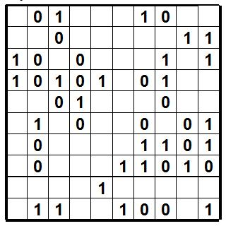
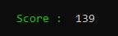
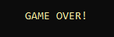
IntroductIon
The aim of this project was coding a binary sudoku game.
The score you earned with binary numbers is written decimal in the score table
If you fill rows, columns or blocks completely, you earn points.
The aim is to reach the maximum score before the game ends.

Slide 4


Progress summary
Requirements for this project:
•C# Knowledge.
•Visual Studio Software.

Slide 5
Task sharıng
Unlike the other groups our third group member did not participate to project, so the two of us did the whole project.
Berke:
Display part of the screen,converting the binary number into the decimal number, determining completely filled rows,columns and blocks.Calculating score, determining end of the game and testing/debugging.
Deniz:
Display part of the screen,converting the binary number into decimal number,generating random pieces,colorising the game screen,placing pieces on the board.Displaying the score every fill and testing/debugging.

Slide 6

Schedulıng
FIRST WEEK:
Creating the variables and screen.
SECOND WEEK:
Creating a two-dimensional dot array.
THIRD WEEK:
Generating random game pieces and placing them.(Changing elements of the array.)
LAST WEEK:
Determining completely filled rows,columns and blocks.Calculating score and determining end of the game.Fixing the problems,and final testing/debugging .

Slide 7

Completed tasks
- We completed all taks.
INCOMPLETE TASKS
-We do not have any incomplete tasks.

Slide 8
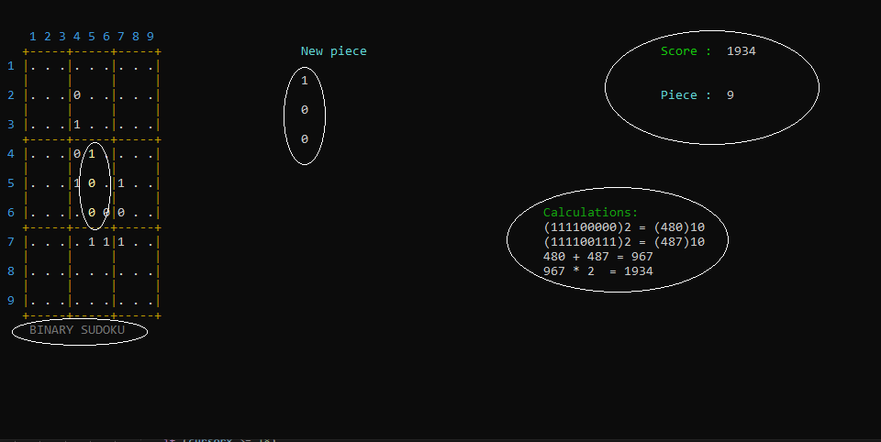
Addıtıonal ımprovements
Colorised and animated texts,
If the piece is not placable in that current position, game gives a warning.
Animated effect for 2x combo!
Player can see the current piece at the cursor.

Slide 9

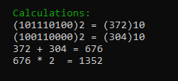
Problems encountered
-Pieces were deleting the game screen.
-Piece placement was not working properly.
-If player gets a 2x combo, points were not displaying correct.

Slide 10
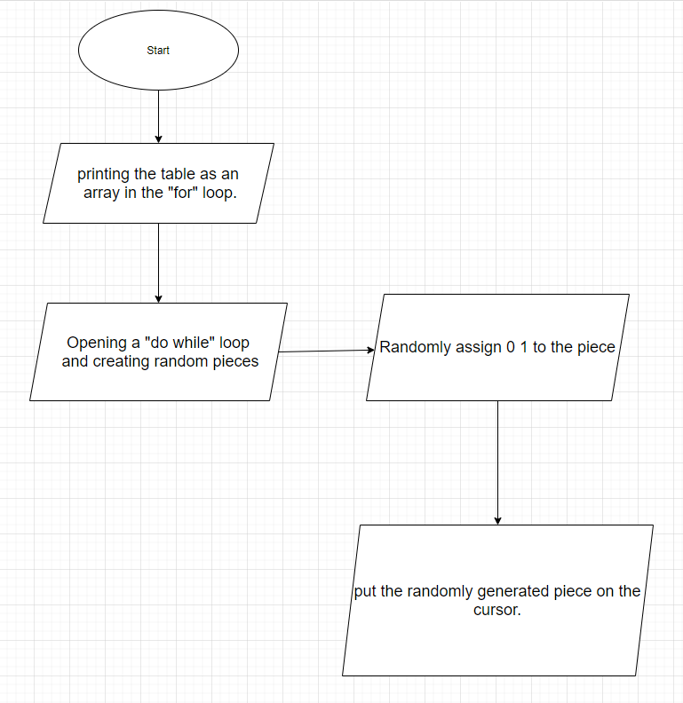
Algorıthms and solutıon strategıes

Slide 11
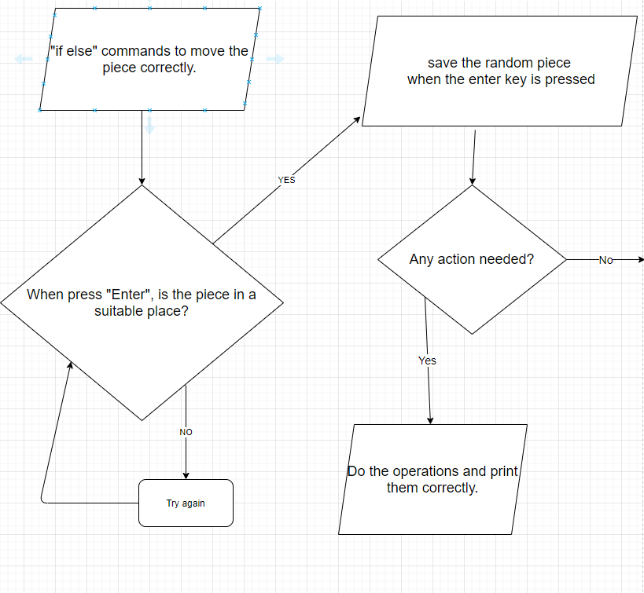
-2-

Slide 12
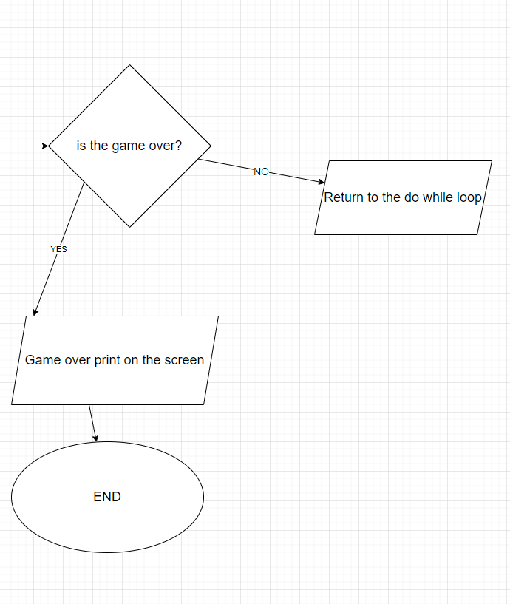
-3-

Slide 13
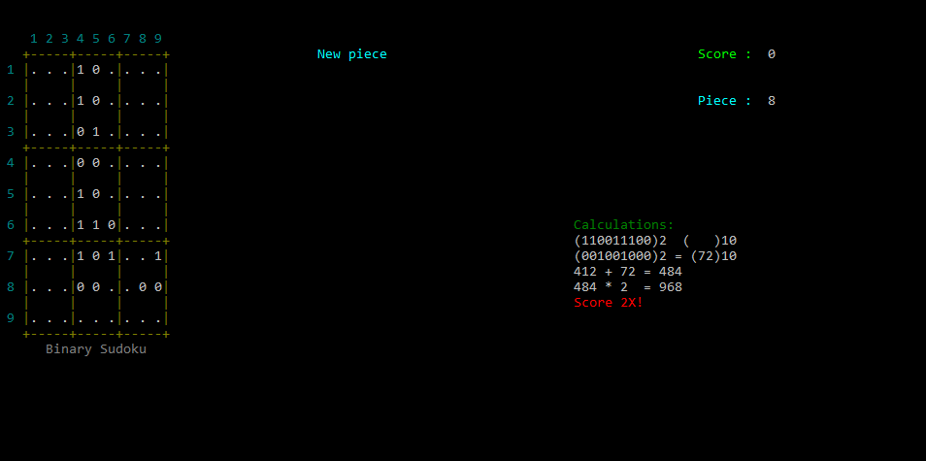
SCREENSHOTS

Slide 14
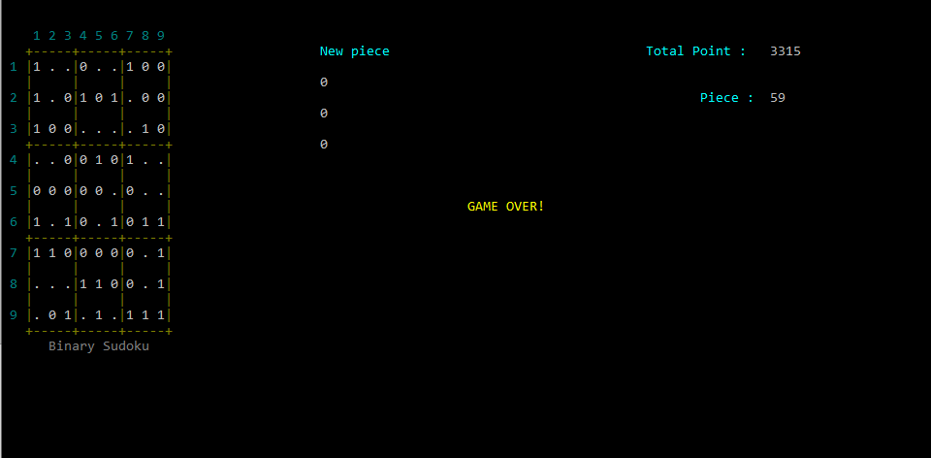
SCREENSHOTS

Slide 15
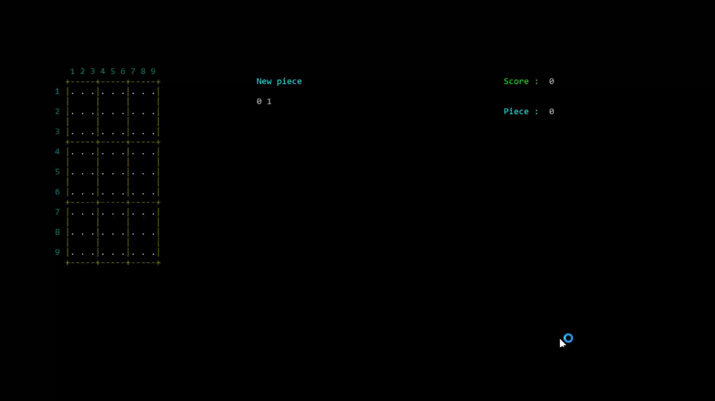
GAMEPLAY vıdeo

Slide 16

CONCLUSION
In conclusion we really learned a lot of new things about C# and improved our problem solution skills while doing this project.
We learned to really be a team in order to finish it because we stayed 2 people while doing the project.
We finished the game in an error-free and pleasing way for the users. Additionally, while doing this we tried to write the code in the best way.

Slide 17
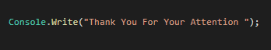
REFERENCES
https://docs.microsoft.com/tr-tr/dotnet/api/system.windows.forms.cursor.position?view=net-5.0
https://online.deu.edu.tr/access/content/group/2409265d-e167-412f-af76-34abcaeb081f/Ders%20İçerikleri/Books/Book1-Illustrated%20CSharp.pdf
(Book :Illustrated C# Sharp 2010 by Daniel M. Solis)

Slide 18
